Slide 1
Deep Learning Techniques for Breast Cancer Risk Prediction
Presented By :
CH.Varun Kumar (19R11A04L3)
G.Mohit (19R11A04L9)
G.Anu Sree (19R11A0M1)
K.Anju (19R11A04M4)
K.Anil Kumar (19R11A04M8)

Slide 2
Content:
1.Introduction
2.Purpose
3.Project Flow
4.Block diagram
5.Flow Chart
6.Training the Machine
7.Testing
8.Applications
9.Advantages
10.Disadvantages
11.Future Scope
12.Conclusion

Slide 3
INTRODUCTION:
Breast cancer is one of the leading causes of death for women globally. According to the World Health Organization (WHO), the number of cancer cases expected in 2025 will be 19.3 million cases. In Egypt, cancer is an increasing problem and especially breast cancer.
The prediction of breast cancer susceptibility – risk assessment prior to occurrence. (Diagnosis) 2. The prediction of breast cancer recurrence – likelihood of redeveloping (Prognosis) 3. The prediction of breast cancer survivability – life expectancy, survival, progression, tumor-drug sensitivity (Prognosis)
Breast cancer is one of the main causes of cancer death worldwide. Computer-aided diagnosis systems showed the potential for improving diagnostic accuracy. But early detection and prevention can significantly reduce the chances of death. It is important to detect breast cancer as early as possible.
The goal is to classify images into two classifications of malignant and benign. As early diagnostics significantly increases the chances of correct treatment and survival. In this application, we are helping the doctors and patients to classify the Type of Tumour for the specific image given with the help of Neural Networks.

Slide 4
Purpose:
What can I do to reduce my risk of breast cancer?Research shows that lifestyle changes can decrease the risk of breast cancer, even in women at high risk. To lower your risk:Limit alcohol.
The more alcohol you drink, the greater your risk of developing breast cancer. The general recommendation — based on research on the effect of alcohol on breast cancer risk — is to limit yourself to no more than one drink a day, as even small amounts increase risk.Maintain a healthy weight.
If your weight is healthy, work to maintain that weight. If you need to lose weight, ask your doctor about healthy strategies to accomplish this. Reduce the number of calories you eat each day and slowly increase the amount of exercise.Be physically active.
Physical activity can help you maintain a healthy weight, which helps prevent breast cancer. Most healthy adults should aim for at least 150 minutes a week of moderate aerobic activity or 75 minutes of vigorous aerobic activity weekly, plus strength training at least twice a week.Breast-feed. Breast-feeding might play a role in breast cancer prevention.
The longer you breast-feed, the greater the protective effect.Limit postmenopausal hormone therapy. Combination hormone therapy may increase the risk of breast cancer. Talk with your doctor about the risks and benefits of hormone therapy.
You might be able to manage your symptoms with nonhormonal therapies and medications. If you decide that the benefits of short-term hormone therapy outweigh the risks, use the lowest dose that works for you and continue to have your doctor monitor the length of time you're taking hormones.

Slide 5
Project flow:
Find below the project flow to be followed while developing the project.
Download the dataset.
Classify the dataset into train and test sets.
Add the neural network layers.
Load the trained images and fit the model.
Test the model.
Save the model and its dependencies.
Build a Web application using flask that integrates with the model built.

Slide 6
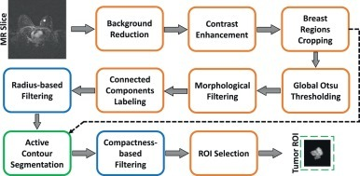
Block Diagram :

Slide 7
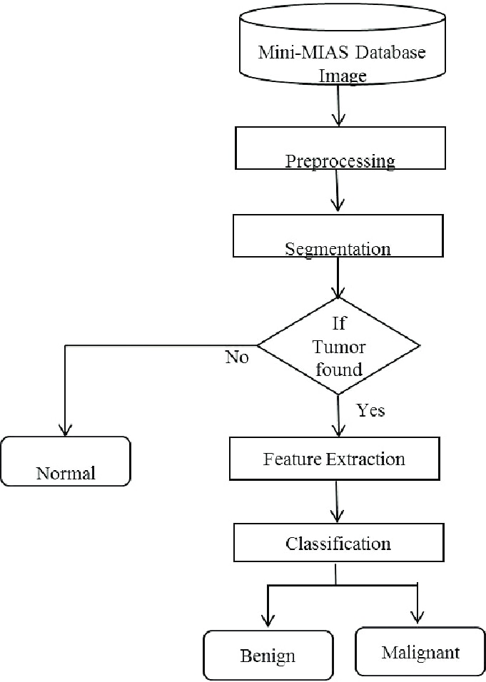
Flow chart:

Slide 8
Training the Machine:
We have used Python which is a statistical mathematical programming language like R instead of MATLAB .
Import image DataGenerator and configure it
Apply image DataGenerator functionality to train and test set
Import required model building libraries
Initialize the model , add convolution layers , pooling layer , flatten layer and dense layer
Compile the model fit and save the model

Slide 9
Testing the Machine:
The model is to be tested with different images to know if it is predicting correctly.
Import the packages that are used to load the model and get the predictions.
Pre-processing the image includes converting the image to array and resizing
according to the model. Give the pre-processed image to the model to know to which class your model belongs to.

Slide 10
Applications:
The main application of this model is to predict the provided image is breast cancer or not. It is well trained so that it will predict the correct data
After the model is built, we will be integrating it into a web application so that normal users can also use it. The users need to give the X-ray images to know the predictions.

Slide 11
Advantages :
You may receive a new treatment before it is widely available to the public.
You can provide researchers with the information they need to continue developing new procedures and introducing new treatment methods.
Your treatment costs may be decreased, since many of the tests and physician visits that are directly related to the clinical trial are paid for by the company or agency sponsoring the study.

Slide 12
Dis advantages:
If you participate in a randomized clinical trial, you may not receive the new treatment being studied.
Many breast cancer clinical trials compare a new treatment along with current therapy versus the current therapy alone. Participants are randomly assigned to one or the other group.
This will be explained to you before you decide to take part.As with other forms of therapy, the new treatment may not work for you, even if it helps others.Insurers do not always cover all of the costs associated with taking part in a clinical trial.
Be sure to talk to your insurance provider before you decide to participate.There may be inconveniences, such as more frequent testing, more time at the doctor's office, and travel commitments.

Slide 13
FUTURE SCOPE:
In future, we shall explore CNN models in deep architectures such as many layers and neurons and also validate on large
cohorts. However, the foremost attention-grabbing future directions are learning and identifying visual clues associated with
histopathology design and morphology to get quantitative semantics feature like the share of dead tissue or neoplasm in WSI.

Slide 14
Conclusion:
This machine-learning model can help breast cancer radiologist to assist them in predicting the malignant tumors at the early stage.
Early stage detection not only leads to less treatment but also improves the chances of survival from breast cancer. Artificial Intelligence in Healthcare

Slide 15
Thank You

